Slide 1

Aditya Engineering College (A)
AUTOMATIC ATTENDANCE TRACING USING IMAGE PROCESSING IN PYTHON
BATCH NUMBER : A17
Presented by:
P.MEHAR SRINIVAS CHOWDARI(19A91A0437)
REPAKA SURESH(19A91A0442)
NALABAI ADITYA(19A91A0431)
Under the guidance of :
Mr. A. Kondababu M.Tech, (Ph.D)
Assistant Professor
Dept. Of ECE

Slide 2
CONTENTS
Aditya Engineering College (A)
Introduction
Literature Survey
Problem Identification
Aim of the Project
Proposed Methodology
Process
Conclusion
References

Slide 3
INTRODUCTION
Aditya Engineering College (A)
In the human body, the face is the most crucial factor in identifying each person as it contains many vital details. There are different prevailing methods to capture person's presence like biometrics to take attendance which is a time-consuming process.
Image processing is a technique for performing operations on an image in order to enhance it or obtain useful information. It's a form of signal processing in which the input is an image and the output is either an image or the image's characteristics.
Biometrics or Fingerprint Scanning is one of the existing techniques that takes time as the student has to explicitly give their impressions onto the machine. But to recognize the face, it explicitly does not require time and is even much lesser compared to other techniques like biometrics.

Slide 4
Literature Survey
Aditya Engineering College (A)
S.No. | Scheme | Title | Methodology | Advantages | Disadvantages
1. | Saeed Mian Qaisar [March,2018] | An Event Driven Attendance Tracker | The idea is to keep the whole system in the standby mode except for the low power motion sensor. On the detection of an event, when a person enters and originates a motion, the front-end embedded processor is alarmed. Later on, it activates the remaining system modules like webcam, communication block, etc. | The classical attendance systems remain active all the time regardless of the presence of intended objects in the system range. It results in an increased system resources utilization and power consumption | In contrast to the classical systems, in the suggested one all system modules remain in the standby mode except for the low power motion detection sensors. The system only functions on the detection of an event of interest.
2. | Mikael Nycander-Barua [July,2019] | An Image Acquisition Method for Face Recognition and Implementation of an Automatic Attendance System for Events | This is developed using the KNN, Naive Bayes, Random Forest, Multi-Layer Perceptron, Decision Tree, Ada boost and Support Vector Machine. Additionally, we compared these classifiers to show which was effective for the dataset in terms of accuracy and execution time | The results showed that the Smart Event Faces Database that used the image acquisition method achieved an accuracy for face recognition of more than 96% on KNN and SVM. In terms of execution time, KNN and SVM had less than 1.5 seconds for classification | It is comparatively high cost and it takes more amount of time for the implementation and execution due to the usage of more algorithms.

Slide 5
Aditya Engineering College (A)
S.No. | Scheme | Title | Methodology | Advantages | Disadvantages
3. | Shailendra Narayan Singh [November,2019] | Real-Time Smart Attendance System using Face Recognition Techniques | It is implemented by using Eigen face values, Principle Component Analysis (PCA) and Convolutional Neural Network (CNN). | The Smart Event Faces Database has excellent accuracy for face recognition and execution time for two classifiers 96% on KNN and SVM. | It uses ada boost algorithm and PCA(principal component analysis which is an unsupervised learning that is difficult to implement.
4. | Duy Dieu NGUYEN [Nov,2021] | Automated Attendance System in the Classroom Using Artificial Intelligence and Internet of Things Technology. | The face detection based on the method of Violas and John which is installed in OpenCV. Then, we continuously sample the correlation features to extract 68 features of eyes, nose, mouth, jaw area at different angles by integrating the dlib library. | The proposed method can detect faces of different image sizes at a distance in a classroom making the system more user-friendly, giving teachers more time to teach and parents know exactly how their children go to school. | The system achieves a correct recognition rate of 89.0% with a detection rate of 7 fps for 1 person in case the environment is well-lit and the face angle is from -20 degrees to 20 degrees only in the opposite direction to the camera.

Slide 6
Aditya Engineering College (A)
S.No. | Scheme | Title | Methodology | Advantages | Disadvantages
5. | Preksha R [April,2014] | Smart Digital Monitoring for Attendance System | The method consists of capturing the individual student or group students Image in the class and compares with the pre stored individual identified images of the students with the1individual or group image, if the student face is found in the group then the attendance will update. The entire code is written in software called MATLAB. | This project is mainly used a new descriptor called SURF. By the experimental studies SURF is best suited for face recognition. The disadvantages of PCA, LDA, and SIFT are overcome in this method. Orientation, scale invariant properties of SURF is the appreciable thing which made the project to work in real time. | Recapturing of image is not done . SURF is difficult to implement and it’s a complex method.

Slide 7
PROBLEM IDENTIFICATION
Aditya Engineering College (A)
The existing systems considers only few images during recognition which yields low accuracy.
This causes problems in posting attendance.
The present members who were not detected in the image will be marked as absent.
In order to overcome this problem, the image is captured continuously till the end of the class. By capturing the image continuously the missed students while capturing at first are recognised in other images.
In this way, the proposed system can identify the persons precisely and more accurately.
There will be no fake attendance and the proxy cannot be done.

Slide 8
AIM OF THE PROJECT
Aditya Engineering College (A)
The main aim of the project is to simplify the conventional attendance marking system and to achieve higher accuracy while recognition and identification of faces. This can be achieved by using KNN(k-nearest neighbors) algorithm.
The management of the attendance can be a great burden on the teachers if it is done by hand. To reduce these efforts Face reognition attendance is proposed.
Face recognition is one of the biometric methods to improve this system. Being a prime feature of biometric verification, facial recognition is being used enormously in several such applications, like video monitoring and CCTV footage system.

Slide 9
Proposed Methodology
Aditya Engineering College (A)
IMAGE CAPTURE
PROCESSING IMAGE
ALGORITHM (KNN)
UPDATE STORED ATTENDANCE
No
RECORD ATTENDENCE
CLASS
END
Yes
POST ATTENDENCE

Slide 10

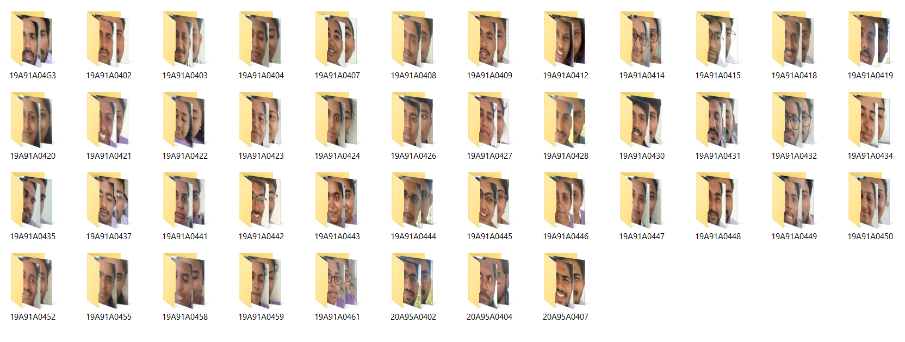
Process
Aditya Engineering College (A)
DATA GATHERING
The images of the students will be captured and stored in a file hierarchy
Main folder
Person 1 folder
Image 1
Image 2
Person 2 folder
Image 2
Image 3
Image 3
Image 1
.
.
.
.
.
.
.
.
.

Slide 11
Process
Aditya Engineering College (A)
ALGORITHM TRAINING
The algorithm need to be trained with the captured images such that it yields maximum accuracy
Person 2 images
Person 1 images
Person 3 images
Trained KNN model
The trained model is saved to the given path so that we can use it for prediction purpose

Slide 12
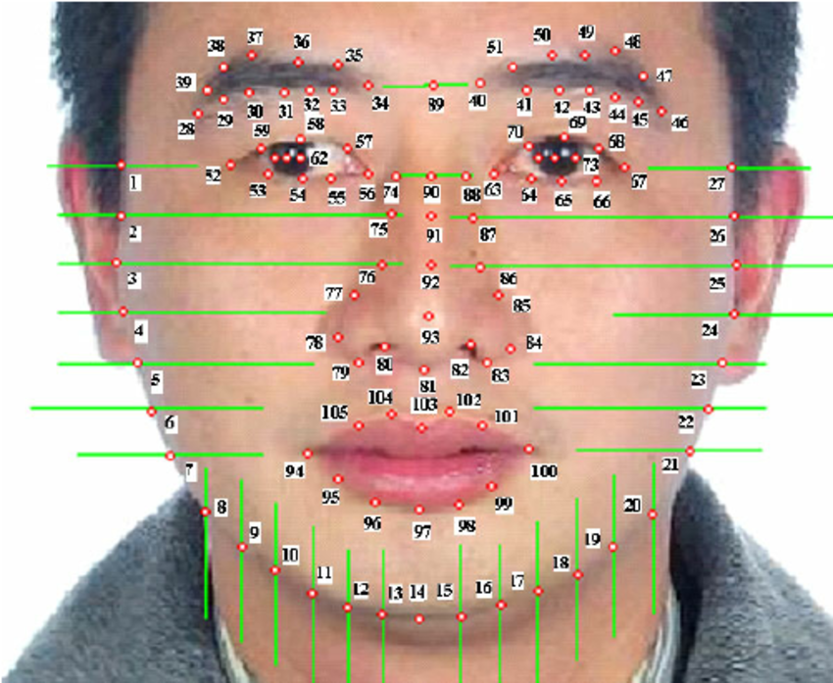
Aditya Engineering College (A)
ALGORITHM WORKING
The in-built face-recognition module in python detects the crucial face points.
These locations and the distance between them is noted and these are different for each individual’s face.
These values are given to a KNN(k-nearest neighbors) algorithm for training
The face of an individual is identified by using the trained model it selects the nearest neighbor for the facial points and shows the result.

Slide 13
Process
Aditya Engineering College (A)
PREDICTION
Face Detection
Face Recognition
Naming Faces
Faces are detected from the image that is captured during class.
Faces detected are identified by using the pre-trained KNN model.
Detected faces will be named by the person’s name and used for marking attendance.

Slide 14
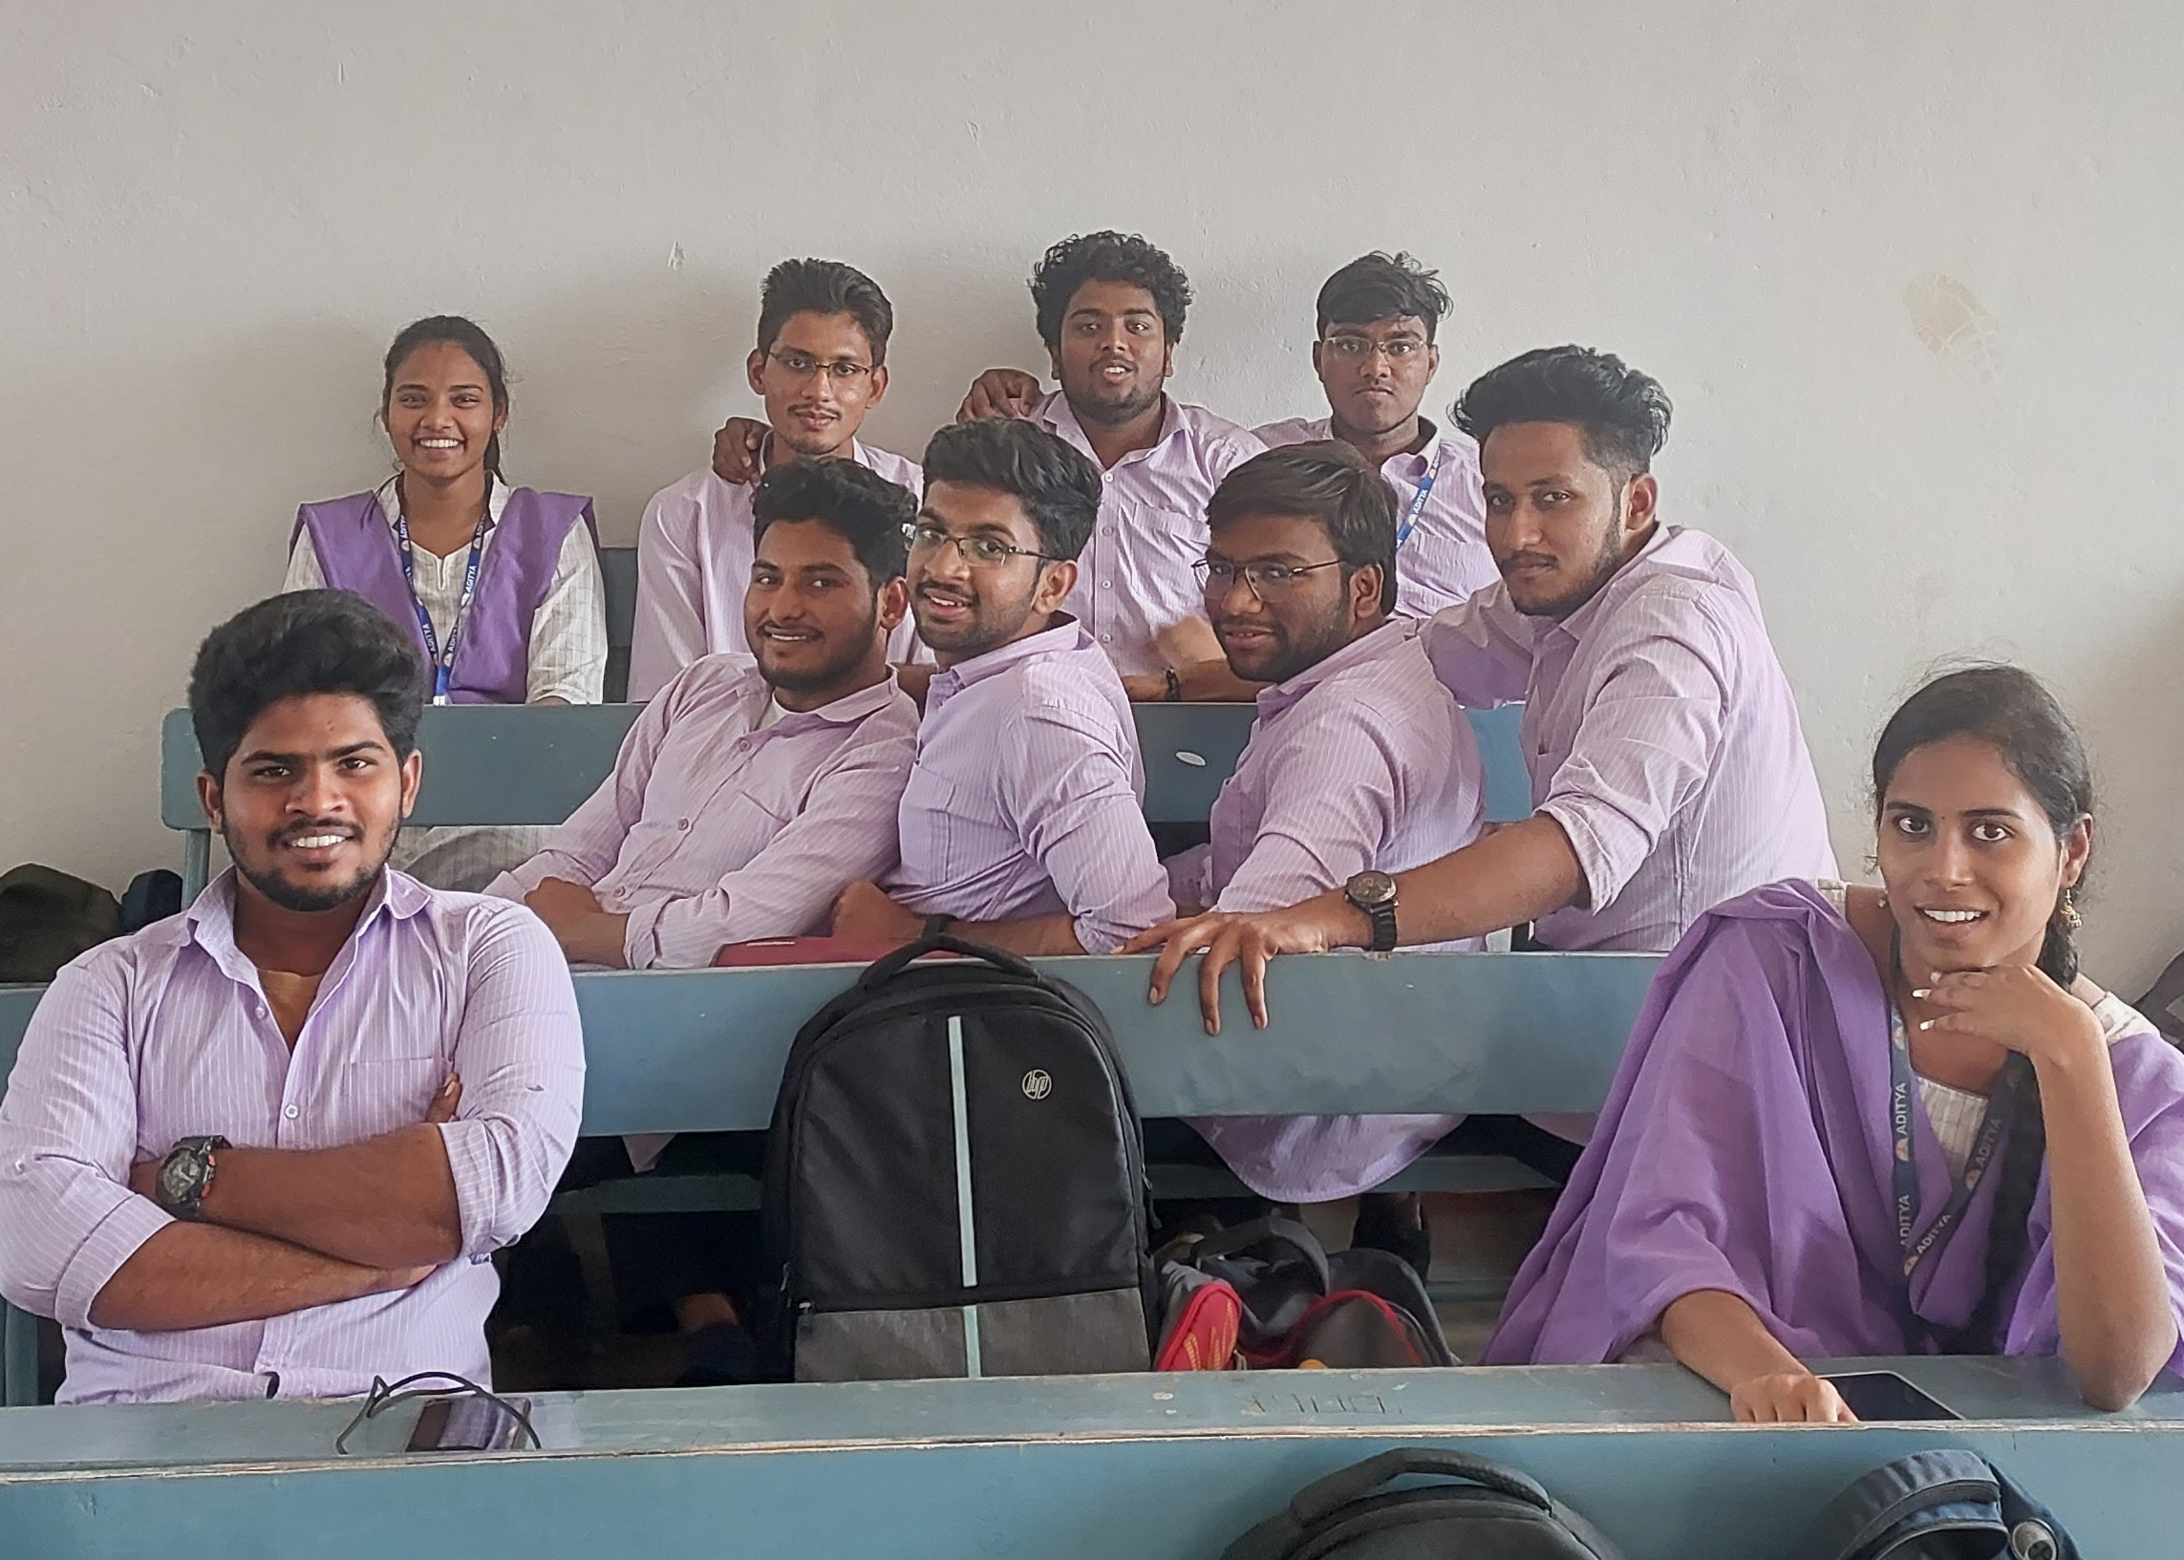
Testing Image 1
Aditya Engineering College (A)

Slide 15
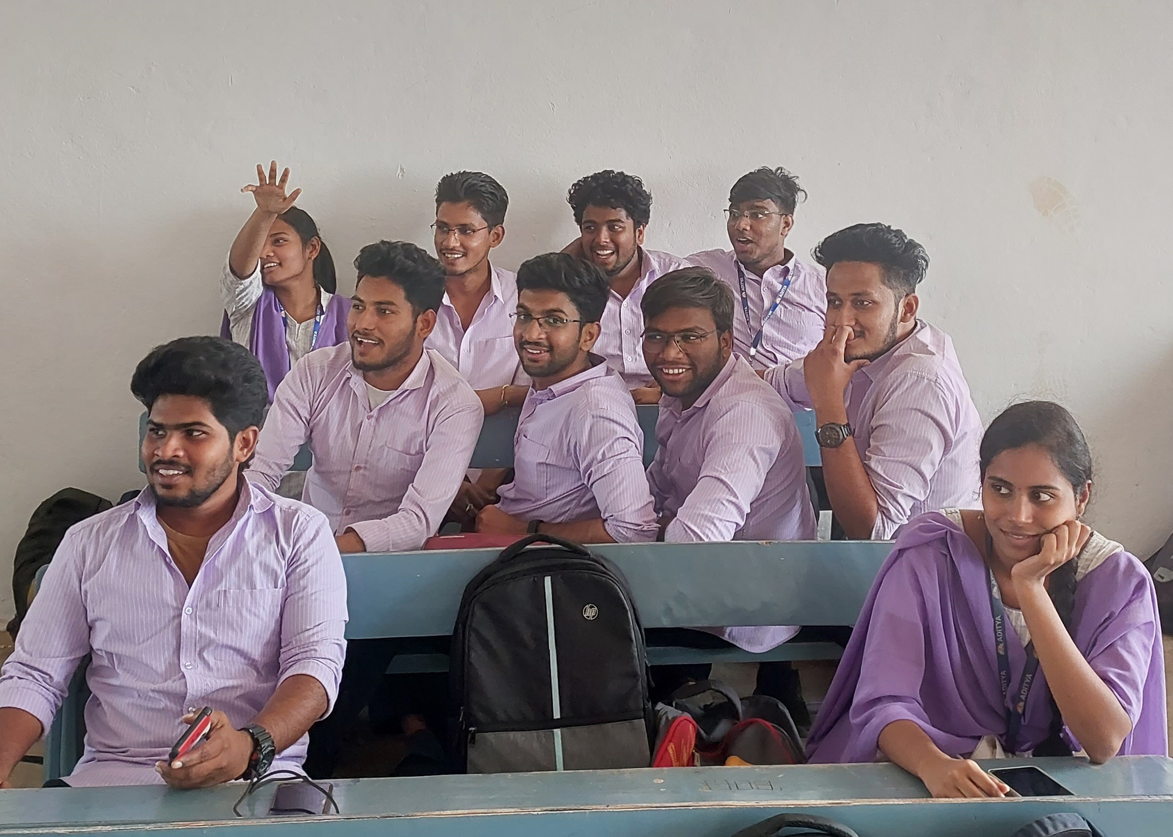
Testing Image 2
Aditya Engineering College (A)

Slide 16
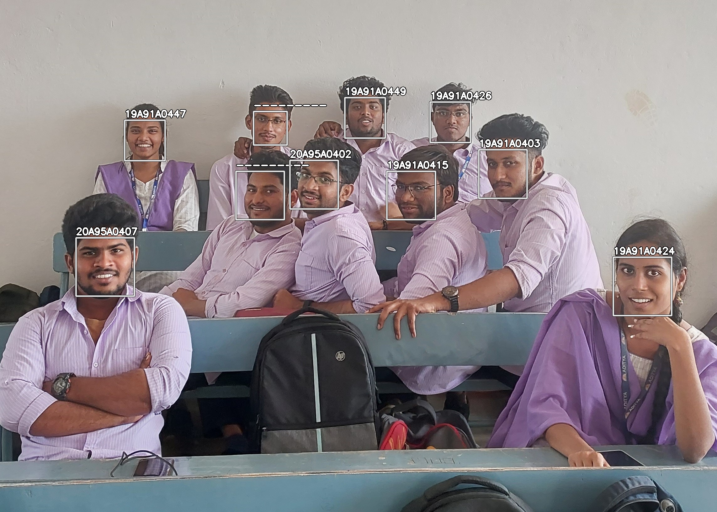
Testing Image 1
Output with Distance threshold = 0.4
Aditya Engineering College (A)

Slide 17

Prediction
Testing Image 2
Output with Distance threshold = 0.4
Aditya Engineering College (A)

Slide 18

Testing Image 1
Output with Distance threshold = 0.6
Aditya Engineering College (A)

Slide 19

Testing Image 2
Output with Distance threshold = 0.6
Aditya Engineering College (A)

Slide 20
Testing Image 1
Output with Distance threshold = 0.49
Aditya Engineering College (A)

Slide 21

Testing Image 1
Output with Distance threshold = 0.49
Aditya Engineering College (A)

Slide 22
Conclusion
Aditya Engineering College (A)
Recapturing the images is the main advantage in the proposed system.
If a person is not detected in a particular image, the person may be captured at any time of the class.
This results in capturing the entire class attendance without even missing a single person in the class.
As we are using inbuilt face-recognition module and getting curtial face points then training them using KNN algorithm it yields more accurate results.

Slide 23
REFERENCES
Aditya Engineering College (A)
[1] “Classroom Attendance Monitoring Using CCTV” Manakula Vinayagar Institute of Technology, Madagadipet, Puducherry, India, IEEE ICSCAN 2020
[2] “An Image Acquisition Method for Face Recognition and Implementation of an Automatic Attendance System for Events” Universidad Peruana de Ciencias Aplicadas Lima, Peru, 2019 IEEE
[3] “An Event Driven Attendance Tracker” R. F. Kurdi College of Engineering, Effat University, Jeddah, KSA,2018 IEEE
[4] “Real-Time Smart Attendance System using Face Recognition Techniques” , Amity University Uttar Pradesh, Noida, 2019 IEEE
[5] “Smart Digital Monitoring for Attendance System”, International Conference on Recent Innovations in Electrical, Electronics & Communication Engineering - (ICRIEECE), 2018 IEEE
[6] “Comparison Of Various Face Recognition Algorithms” International Journal of Advanced Research in Science, Engineering and Technology Vol. 4, Issue 2 , February 2017
[7] “LBPH-Based Enhanced Real Time Face Recognition “International Journal of Advanced Computer Science and Applications Vol.10, No. 5, Published in 2019.

Slide 24
REFERENCES
Aditya Engineering College (A)
[8] ” Face Detection using LBP Features”Jo Chang-yeon CS 229 Final Project Report December 12 ,2008.
[9] “Face Recognition System Based on LBPH Algorithm”, International Journal of Engineering & advanced technology(IJEAT),Volume-8,Issue5S,May,2019.
[10] Himanshu Tiwari1“Live Attendance System via Face Recognition” International Journal for Research in Applied Science & Engineering Technology (IJRASET) Volume 6 Issue IV, April 2018.
[11] “FACE RECOGNITION TECHNIQUE USING ICA AND LBPH”, Khusbu Rani1, Sukhbir , kamboj2,IRJET,Volume-04,issu08,August-2017
[12] E.Varadharajan, R.Dharani, S.Jeevitha, B.Kavinmathi, S.Hemalatha,Automatic attendance management system using face detection, Online International Conference on Green Engineering and Technologies (IC-GET), 978-1-5090-4556-3/16/$31.00 ©2016 IEEE.
[13] Naveed Khan Balcoh, M.HaroonYousaf, Waqar Ahma nd M.IramBaig, Algorithm for efficient Attendance Management: FaceRecognition Based approach, International Journal of Computer Science Issue, Vol.9, Issue 4, No 1, July 2012.
[14] An Accurate System for Face Detection and Recognition Abdelmgeid A. Ali1, Tarek Abd El-Hafeez and Yosra Khalaf Mohany Journal of Advances in Mathematics and Computer Science33(3): 1-19, 2019; Article no.JAMCS.49994 ISSN: 2456-9968 tems and Applications (ICEDSA), 2016 5th International Conference on, pp. 1-4. IEEE, 201

Slide 25

Aditya Engineering College (A)
Any Queries

Slide 26
Aditya Engineering College (A)
Thank You

Slide 27
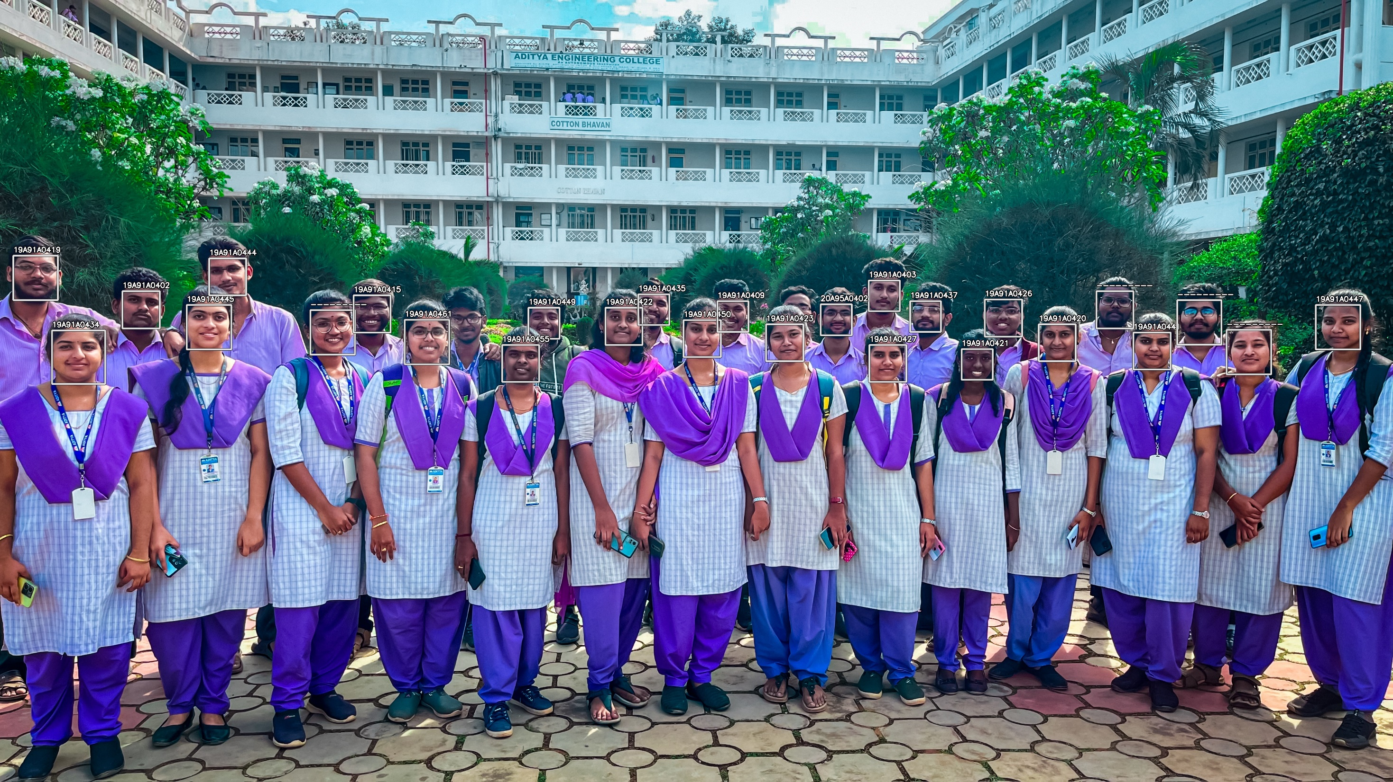
APPENDIX

